Slide 1

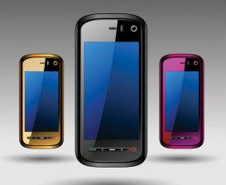


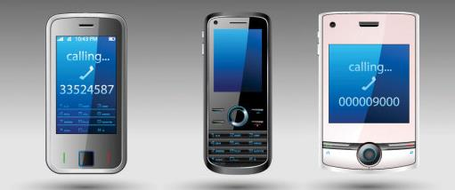
HTML5 Everywhere
Making a Web page work everywhere
Telerik Software Academy
Learning & Development Team
http://academy.telerik.com

Slide 2

Table of Contents
HTML5 and the Web today
What is HTML5?
Browser support
Backward and mobile
Support for older browsers and mobile
Shivs and Shims
Polyfills
Modernizr
CSS boiler plates

Slide 3


HTML5 and The Web Today
Making the fine web

Slide 4
HTML5 and The Web Today
The Web today is vast
Lots of ways to reach the web (mobile, PC, TV)
Lots of operating systems
Windows, Mac OSX, Android, Firefox OS, Linux
Lots of browsers with version specifics
Google Chrome, Mozilla Firefox, Apple Safari, Internet Explorer, Opera
Lots of web browser engines
Gecko ,Presto*, Trident, WebKit, Blink
Engines act differently on each OS or browser

Slide 5
HTML5 Support
Browsers dive into HTML5 with different steps
Most major browsers for desktop and mobile support primary HTML5 specifics
Some browser vendors thought it through
Firefox and Chrome update silently
Opera and Safari offer to download and update
Internet Explorer is hardest to update
Update from browser (can be forbidden)
Use Windows Update

Slide 6
HTML5 Support (2)
Yet waiting for users to update their browser is not reliable
Sometimes users are afraid or unwilling to update
Sometimes administrators restrict updates due to corporate policies
Sometimes the OS doesn't support newer versions
The best XP users get is Internet Explorer 8!

Slide 7
HTML5 Options
What then?
Use something that is supported everywhere?
Like HTML4/XHTML
Not good enough
Don't support Internet Explorer?
Still not OK…
IE holds good ~25% of the browsers share for 2013
Make your site look just as good on older browsers, and good enough on the oldest
Using a bit of JavaScript

Slide 8
Backward Compatibility
Looking good on most browsers

Slide 9
Backward Compatibility
How to make a web page look good on most browsers?
Two common approaches
Limit the HTML features so every browser can understand them
Use the top features of modern web design and do a little JavaScript to leverage the platform

Slide 10
Backward Compatibility (2)
How to use the features of HTML 5 in browsers back to IE6?
Need to use something to flatten the browser capabilities
HTML5 browser support is far from complete and some users still tend to use IE7/IE8
There are lots of gaps in there
Shivs, Shims and Polyfills to the rescue!

Slide 11

Shims, Shivs and Polyfills
Fill the gaps in browsers

Slide 12
Shims and Shivs
Shims and shivs are a small libraries that fill gaps in a platform
Mainly used when the API changes and causes compatibility issues
The older API can still be supported by a thin compatibility layer on top of the newer code

Slide 13

Polyfills
Polyfills are a similar concept to shims/shivs
They provide fallback functionality for features still not implemented natively in the browser
When the users update their browser they will have the same experience, but use the native implementation

Slide 14
Shims, Shivs and Polyfills
Shivs and Shims make HTML5 things happen in less-supported browsers
They fill the gaps in:
HTML - markup features, new tags, meta tags, attributes, etc…
CSS - style properties, gradients, fonts embedding, data-urls, border radius etc…
JavaScript - storages, web workers, canvas, SVG, etc…

Slide 15
HTML5Shiv
html5shiv.js is the most used shiv for HTML5 elements
It enables styling for HTML5 elements in older versions of IE (IE8-)
https://code.google.com/p/html5shiv/

Slide 16

html5shiv
Live Demo

Slide 17
CSS 3 Pie
CSS 3 Pie is a polyfill for Internet Explorer
It enables CSS3 features in older versions of IE
How does it work?
Download pie.js and pie.htc
Include pie.js into the Web page
Add the following to the styles
behavior: url(scripts/css3-pie/pie.htc);

Slide 18

CSS3 Pie Shim
Live Demo

Slide 19
Array.indexOf() shim
Some browsers do not support Array.indexOf()
Need a shim to make it happen
if (!Array.prototype.indexOf) {
function arrayIndexOf (searchElement, fromIndex) {
for (var i = fromIndex || 0; i < this.length; i++) {
if (this[i] === searchElement) {
return i;
}
}
return -1;
}
Array.prototype.indexOf = arrayIndexOf;
}

Slide 20
Array.indexOf Shim
Live Demo

Slide 21
Audio/Video
Playing audio or video with pure HTML
Available since HTML5
The most common approach is to use external plugin to fallback the audio/video support
Like Flash or Silverlight

Slide 22
Audio Polyfill
Live Demo

Slide 23

What is Modernizr.js?
JS Library to Detect Native HTML5 Features

Slide 24
The Modernizr
Modernizr is a JavaScript library that detects HTML5 and CSS3 features in the browser
http://modernizr.com/download/
Modernizr has three primary tasks
Enables html5shiv if necessary
Detects html 5 support through adding classes to the HTML element
Class js for "js is supported" and "no-js" otherwise
YepNope loading
If a features is not supported - load a polyfill

Slide 25
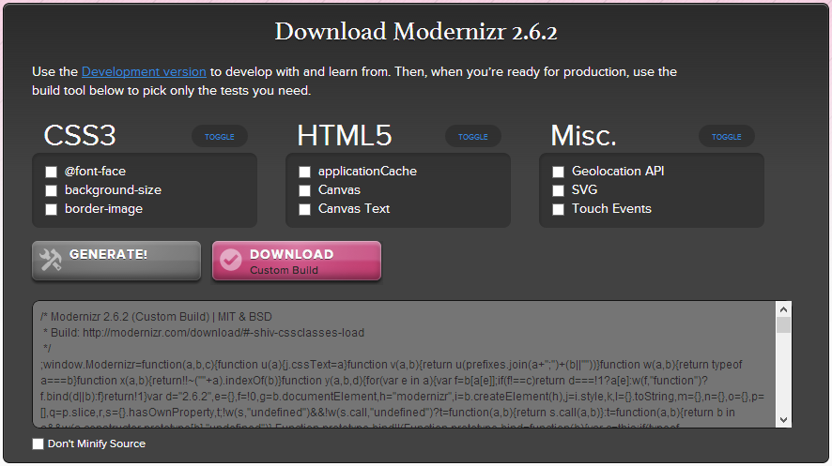
Installing and Configuring Modernizr

Slide 26
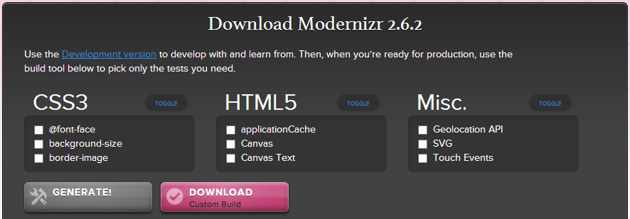
Installing Modernizr
Steps to install Modernizer:
Go to http://modernizr.com/download/
Select features you want to use
Generate and download your customized Modernizr JS code

Slide 27
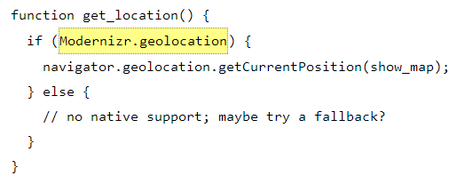
Modernizr: Detecting HTML5 Features

Slide 28
Detecting HTML5 Features
Modernizer can check for HTML5 / CSS3 features through JavaScript:
Features detected by Modernizr:
http://modernizr.com/docs/#s2
if (Modernizr.canvas) {
alert('HTML5 canvas is supported');
} else {
alert('HTML5 canvas is NOT supported');
}

Slide 29
Modernizr: Detecting HTML5 Features
Live Demo

Slide 30
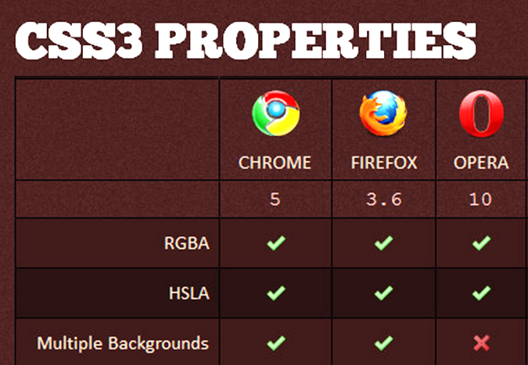
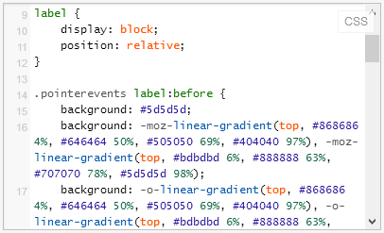
Modernizr: Detecting CSS3 Features & Fallbacks

Slide 31
Modernizr: Detecting CSS3 Features & Fallbacks
On document load Modernizr detects which features are supported
Adds classes "feature" / "no-feature" for the features to the HTML element
Example features:
canvas, rgba, sessionstorage, etc.
If the features are supported
no-canvas, no-rgba, no-sessionstorage, etc.
If the features are not supported

Slide 32
CSS3 Fallbacks
If CSS gradients are not supported, use a fallback gradient with PNG repeated by X:
<script src="modernizr.js"></script>
<style>
.box {
width: 150px;
height: 150px;
border: 1px solid black;
}
.cssgradients .box {
// css gradients code
}
.no-cssgradients .box {
background: url(gradient.png) 0 0 repeat-x;
}
</style>

Slide 33
Modernizr: Detecting CSS3 Features & Fallbacks
Live Demo

Slide 34
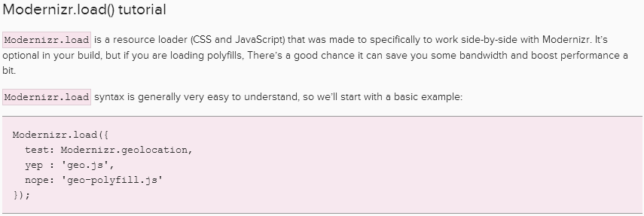
Modernizr Load
Yep / Nope Loading of JS Polyfills for Missing HTML5 Features

Slide 35
Modernizr Load
Modernizr can test for features and load resources depending on their support
Used to load polyfills for unsupported features
<script src="modernizr.js"></script>
<script>
Modernizr.load({
test: Modernizr.audio,
nope: 'http://api.html5media.info/1.1.5/ html5media.min.js'
});
</script>

Slide 36
Modernizr Load
Live Demo

Slide 37
CSS Boiler Plates
Resetting made simple

Slide 38
Boiler Plates
Lots of browsers over there
Each browser defines its own default styles
Need to reset everything we use
Boiler plates deliver a ready-to-use CSS style resets
http://html5boilerplate.com/
http://www.getskeleton.com
*{margin:0; padding:0}
html,body,div,header…{margin:0;padding:0}

Slide 39
HTML5 Everywhere
http://academy.telerik.com

Slide 40
Homework
*Make the web page task1.html with styles task1.css (or task1.less) to work on all desktop browsers, including IE7
You are not allowed to change the original CSS(LESS) and HTML. You can only expand it
Use shivs, shims or polyfills
*Make a web page that detects the current geolocation
The web page should work fine in all desktop browsers, including IE7

Slide 41
Homework
*Create a web page that contains the following input types
range, number, email, date, color, datetime, month, search, tel, time, url, week
And it must work on all desktop browsers (IE7+)
Research about Webshims Lib

